Slide 1
Financial Statement Analysis

Slide 2
Financial Statement Analysis: Balance sheet, Profit and Loss Account, Economic vs Accounting Profit, Changes in Financial Position

Slide 3
Is the company profitable?
Is there enough cash to meet payroll needs?
How much debt does the company have?
Has the company consistently paid cash dividends?
Should the company invest money to expand?

Slide 4
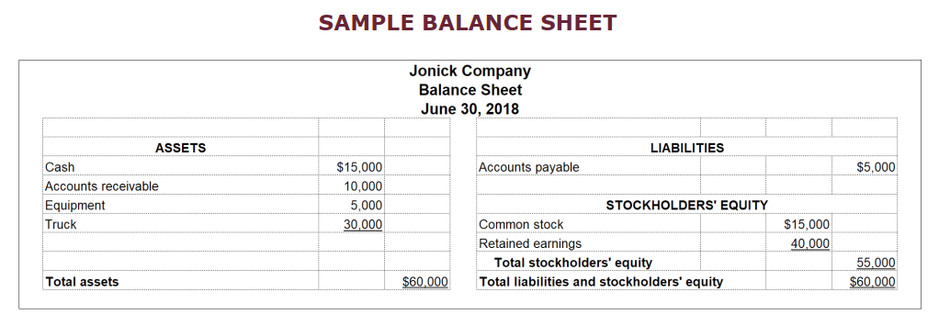

Slide 5
Assets
Something of value the company owns
Tangible or intangible
Current Assets:
Cash , marketable securities, accounts and notes receivables, inventories, prepaid expenses
Generally appear in the BS as most liquid to least liquid
Property, Plant and equipments:
long-term investments:
Intangible assets lack physical substances, but they provide substantial value to the company

Slide 6
Liabilities
Existing debt and obligations owed to the third parties
Current Liabilities (short-term)
Accounts payable and Notes Payables, Current portion of long term obligations, Unearned revenues
Non Current Liabilities
long -term debts such as notes, bonds, and mortgages payables, Long-term lease obligations, Deferred income tax liabilities, Pension obligations
A deferred income tax liability can be thought of as the income tax expected to be paid in future years on income that has already been reported in the income statement but which, because of the tax law, has not been taxed.
The liability is valued using the enacted income tax rates expected to prevail in the future when the income is taxed.

Slide 7
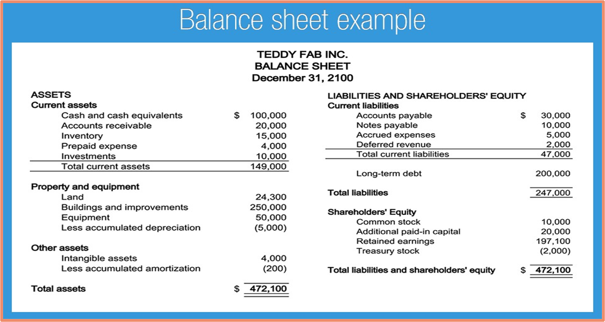

Slide 8
Owner’s equity
Amount owed to the owner or owners by the company
Assets-liabilities = owner’s equity → net assets
Components:
Owner’s investment-owner’s drawing = net investments

Slide 9
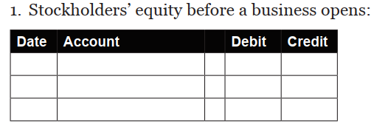
CHANGES IN STOCKHOLDERS’ EQUITY
Common Stock + Retained Earnings = Total Stockholders’ Equity
An example of journal entry to showcase stockholders equity change

Slide 10
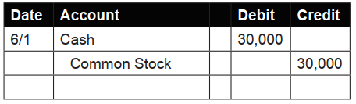
Stockholders’ equity after 30 stockholders invest $1,000 each, for a total of $30,000:
Common stock + retained earnings = stockholders equity
30000 + 0 = 30,000
Each investor is now worth $1,000 in the business.

Slide 11
Stockholders’ equity after one month of operations
Fees Earned is $65,000 and total expenses are $5,000
Common stock + retained earnings = stockholders equity
?
Stockholders’ equity after one month of operations and after each of the thirty investors receives a cash dividend payment of $500
Common stock + retained earnings = stockholders equity
?

Slide 12
Generally four components:
Outstanding shares:
•it is the amount of company stock that has been sold to investors and not repurchased by the company
•it represents the total amount of stock the company has issued to the public investors, company officers, and company insiders
Additional paid-in capital:
•Shareholders' equity also includes the amount of money paid for shares of stock above the stated par value
•Par value – price of each stock

Slide 13
Retained earning:
•When a company retains income instead of paying it out as dividend a positive balance is created
•It can be mentioned as retention ratio or retained surplus
Treasury stock:
•Number of shares re-purchased from investors by the company
•Treasury stock reduces total shareholders' equity on a company's balance sheet.
•This figure is subtracted from a company's total equity

Slide 15
A Profit and Loss (P&L) statement measures a company’s sales and expenses during a specified period of time
Shows a company's financial progress
To construct a P&L statements
net sales
cost of goods sold
gross margin
selling and administrative expenses ( operating expense)
net profit.
Profit and Loss account

Slide 16
Why prepare and P&L statements?
will give owners timely and important information
adjustments can be done to recoup losses or decrease expenses
allows outsiders to evaluate your ability to manage and use your company’s resources
It is the record of a business’ operation that is used to assess taxes on profits earned

Slide 17
Components of P&L statements
Net Sales
Net Operating Profit = Gross Margin - Selling and Administrative Expenses
Net Profit Before Taxes = Net Operating Profit + (Other Income - Other Expenses)
Net profit = Net Profit Before Taxes - Income Taxes

Slide 18
Net Sales
Total sales less allowances, returns and trade discounts
The amount allowed for returns will vary considerably between different types of businesses
Trade discounts means the difference between catalog price and the actual price paid by the customer

Slide 19
Cost of good sold
also called the cost of sales.
For retailers and wholesalers it is the total price paid for the products sold during the accounting period. It is just the price of the goods.
It does not include selling or administrative expenses (these expenses are listed elsewhere on the P&L statement)
For retailers and wholesalers the cost of good sold may be computed either directly or indirectly

Slide 20
Cost of good sold
Direct method: based on inventory
CGS: Value of inventory at the beginning + value of good purchased during the accounting period - value of inventory at the end of the accounting period
( inventory consumed)

Slide 21
Indirect method: deflating sales figures
For example, if a retail store has a storewide gross margin (or markup) of 40 percent and sales of ₹ 100,000 are recorded during the accounting period, the cost of goods sold would be ₹60,000.
Total sale x Gross margin (%) = Gross margin (₹)
₹ 100,000 x 40%= ₹40,000
Total sale (₹) – Gross margin (₹)= cost of good sold (₹)
₹100,000- ₹40,000 = ₹60,000

Slide 22
CGS: for manufacturers
both the acquisition of raw materials to create a product and the costs related to its manufacture
direct costs and indirect costs.
Direct cost includes : inventory cost, cost of raw materials, work-in-process inventories and direct labor cost
Indirect cost includes: indirect labor, factory overhead and material supplies

Slide 23
Net sale- cost of good sold = Gross profit
Gross Profit - Selling and Administrative Expenses = Net Operating Profit
Selling and administrative expenses ( operating expense)
Net Operating Profit + (Other Income - Other Expenses) = Net Profit Before Taxes
Net profit before taxes – Income taxes = Net profit

Slide 24
Other income and other expenses:
any unusual income or expense items not directly related to the operations of the business
(+) Other income includes income from interest, dividends, miscellaneous sales, rents, royalties and gains from the sale of capital assets
(-) Other expenses includes unexpected losses unrelated to normal course of business, and a loss from disposal of equipment

Slide 25
Total sale
Net Sale
Gross Profit
Net (operating) Profit
Net Profit Before Tax
Net Profit

Slide 26


Gross Profit Margin:
Net Profit Margin:

Slide 27
Question:1
From the following P & L account given by a company , calculate the GPM and NPM
Sales revenue $73000
Cost of Sales Opening stock $8000
Purchases 13500
Closing stock 6750
Gross Profit —---
Other Income $10267
Expenses $43750
Net Profit —-----
Taxes (@ 14%) —-----

Slide 28
Q2. Calculate NPM
Sales revenue = ₹ 500,000
Income tax = 20%
Selling cost = ₹80,000
Sales return =1% of sales
Labour cost = ₹75,000
Cost of raw material = ₹25,000
Trade discount = 2% of sales
Loss estimated due to fire=₹72,000
Cost of raw material = ₹ 25,000
Inventory consumed = ₹28,000
Gain from old capital stock = ₹9,000
Royalties earned = ₹9,000
Administration expenditure =₹74,000
Factory overhead charges = ₹28,000
Interest earned = ₹10,000

Slide 29
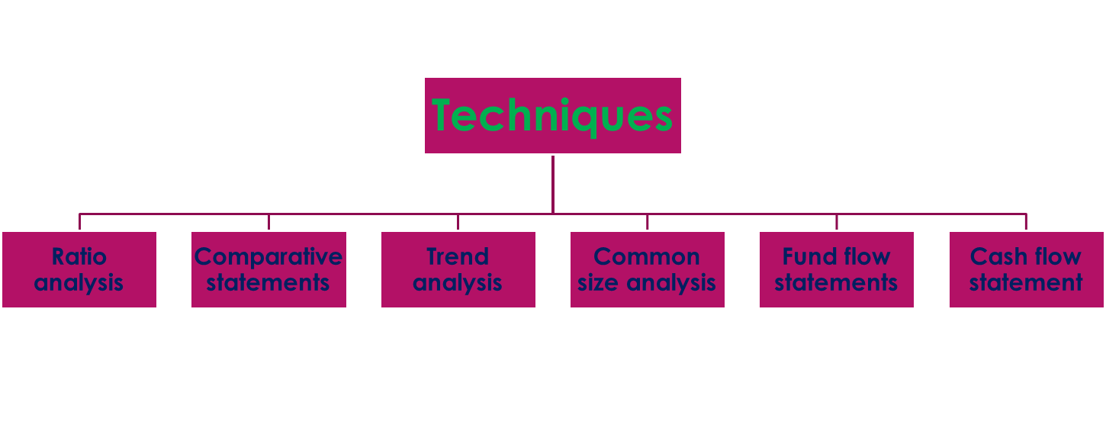
Financial statement analysis

Slide 30
Comparative statement analysis
Comparative statement analysis is an analysis of financial statement at different period of time
Again classified into two major parts such as comparative balance sheet analysis and comparative profit and loss account analysis
Comparative Balance Sheet Analysis
Concentrates only the balance sheet of the concern at different period of time
This type of analysis helps to understand the real financial position of the concern as well as how the assets, liabilities and capitals are placed during a particular period

Slide 31
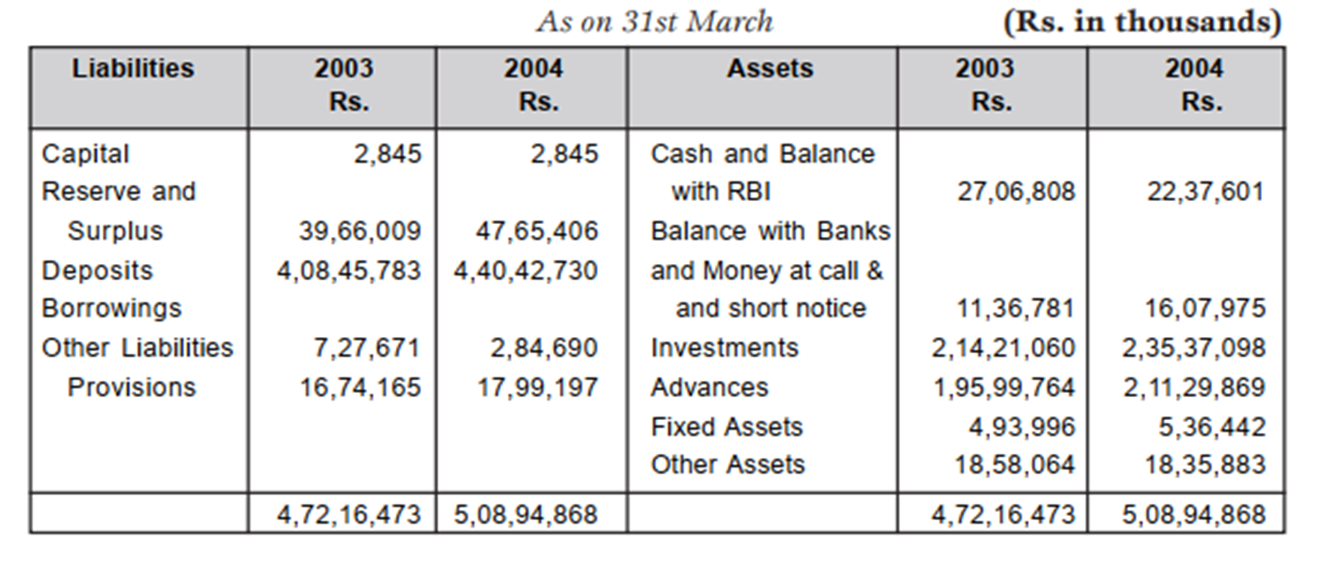
Let’s discuss the operational performance

Slide 32
Operational performance
Particulars | Year ending 31st March |  | Increased/ Decreased amount | Increased/ Decreased (%)
 | 2003 Rs | 2004 Rs
Assets Current Assets Cash and balance with RBI Balance with bank and … | 27,06,808 11,36,781 | 22,37,601 16,07,975 | (-) 4,69,207 (+) 4,71,94 | (-)17.33 (+)41.45
Total current asset | 38,43,589 | 38,45,576 | 1987 | 0.052

Slide 33
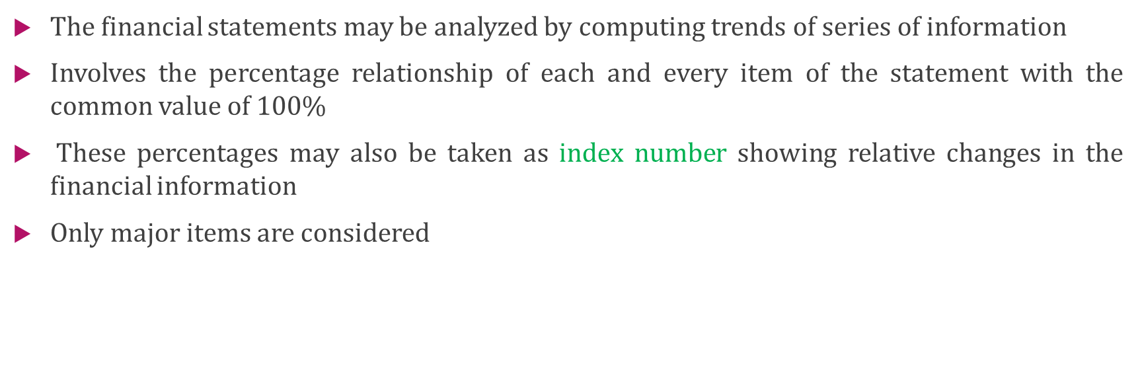
Trend analysis

Slide 34
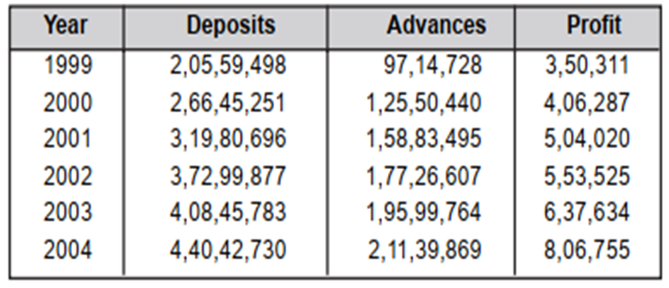
Let’s calculate trend analysis
Year | Deposit
 | Amount Rs. | Trend (%)
1999 | 2.05,59,498 | 100
2000 | 2,66,45,251 | 129.6
2001 | 3,19,80,696 | 155.5
2002 | 3,72,99,877 | 181.4
2003 | 4,08,45,783 | 198.7
2004 | 4,40,42,730 | 214.2

Slide 35
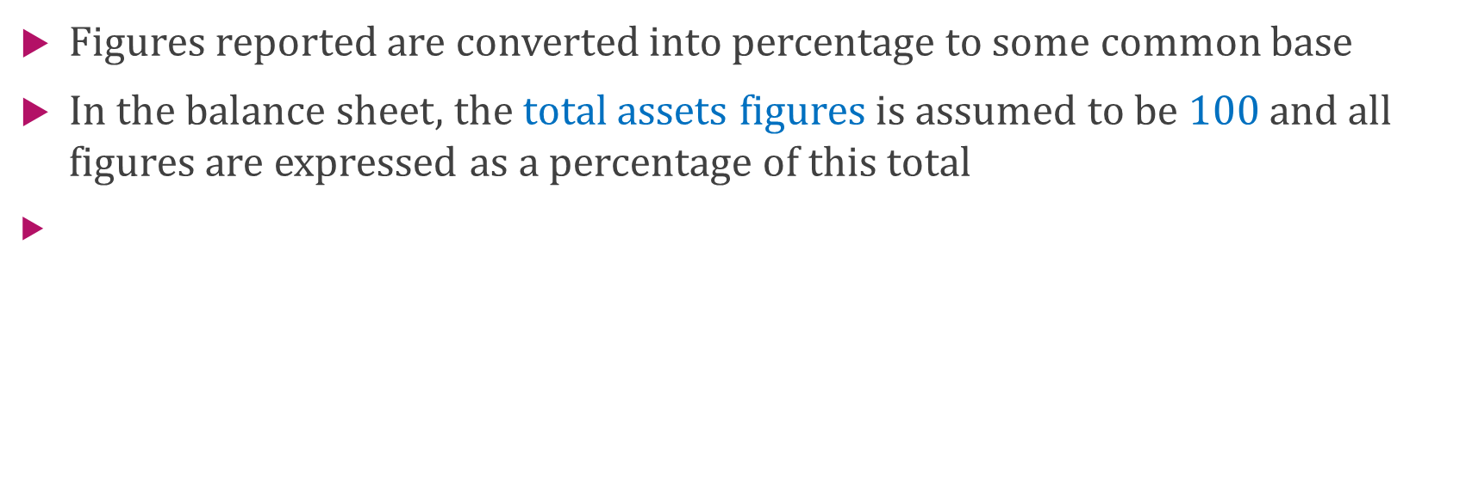
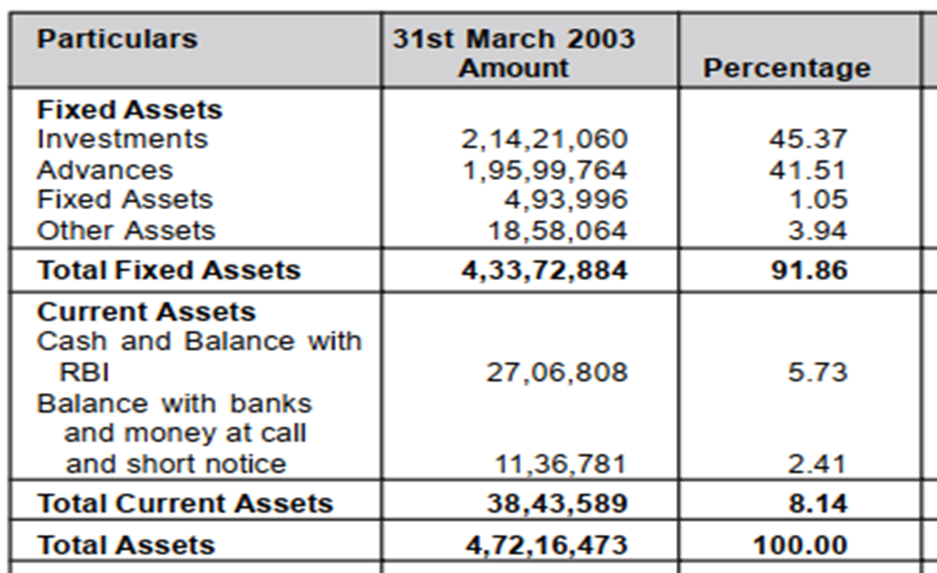
Common size analysis

Slide 36
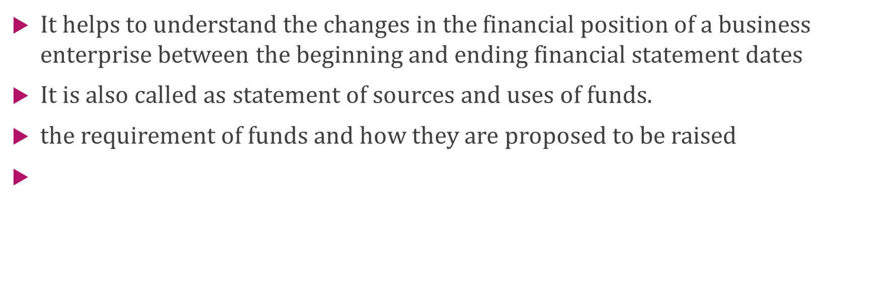
Funds flow statements

Slide 37
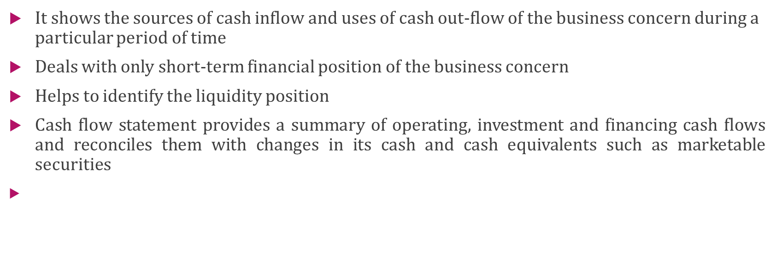
Cash flow statements

Slide 38
Difference?
Funds Flow Statements | Cash Flow Statements
1.Report of the movements of Working capital 2.Explains about how working capital raised and used 3.Indicates the results of current financial management 4.Increase or decrease in working capital is recorded 5.There is no opening and closing balance | 1.Report of the sources and uses of cash 2.Explain the inflow and outflow of cash during a particular period 3.Indicates the factors contributing to the reduction cash balances in spite of profit (+) 4.Only cash receipts and payments are recorded 5.Starts with opening cash balances and ends with closing cash balances

